Slide 1
‘Insetting’ and net zero: opportunities for sub-regional collaboration
Presentation to Heathrow Special Project Group Summit, September 2021

Slide 2
Agenda
Voluntary Carbon Markets
TSVCM – Focus & Methodologies
Insetting Study & Definition 2015
International Platform for Insetting 2021
World Resources Institute Carbon Credits Overview
CORSIA – an Opportunity?
Carbon Credits & ‘Patient Capital’
Emtec Case Study
Questions?

Slide 3
Voluntary Carbon Markets
Voluntary Carbon Markets – 30 years of primarily Nature-based solutions - $700m 2019
TSVCM – newly forming ‘industrialised’ market serving global Corporations with High Integrity credits - $100bn per annum by 2030 – “putting billions into the hands of those who can do something about the problems”
Over the Counter (OTC) Corporate trading to continue – Important funding source for local/circular economy process [Insetting rather than Offsetting]

Slide 4
Tsvcm - Focus and Methodologies
Avoidance & Reduction
Nature-based avoidance/reduction (NBS)
Tech-based avoidance/reduction
Removal & Sequestration
Technology-based
Nature-based
15 Independent Standards (e.g., VCS, Gold Standard)
4 Key Offset types (see Left)
12 Methodology types (Pareto-based)
100+ Methodologies in total (including CDM)
10,000+ Projects over past 30 years
Exponential increase in projects now needed with 2/3rds of funds likely to be NBS focused
Historically these are North/South transactions
Notes:
In other words, this is a roadmap of precedents that can comply/engage credits across the globe

Slide 5
ICROa/Bristol Uni ‘Insetting’ Study and Definition 2015/16
Insetting is a direct extension from Offsetting.
Insetting – Developing carbon offset projects within a company’s own supply chain and supply chain communities
The International Carbon Reduction and Offset Alliance (ICROA) is a non-profit organisation made up of the leading carbon reduction and offset providers in the voluntary carbon markets.
ICROA is part of the governance structure of the newly forming Taskforce Market
Notes:
Insetting is a direct extension from Offsetting. While Offsetting refers to the purchase of carbon credits from a carbon reduction project that is unrelated to the company in question, the definition of Insetting necessitates that the location of the carbon offset project is within the company’s own supply chain, and supply chain communities.
Practically speaking, reference to the ‘supply chain and supply chain communities’ equates to any carbon reduction project that is located directly within the upstream supply chain of the company, and projects that are located within the geographical region that is directly impacted by the supply chain activity and that directly affects the stakeholders of that supply chain.
The management strategy is comparable to Offsetting in terms of its requirement for: (i), a voluntary corporate investment in a project that generates carbon credits; (ii) verification of the project that generates carbon credits by a carbon offset standard such as the Verified Carbon Standard or Gold Standard; and (iii) the application of purchased credits to offset the company’s own operational emissions.

Slide 6
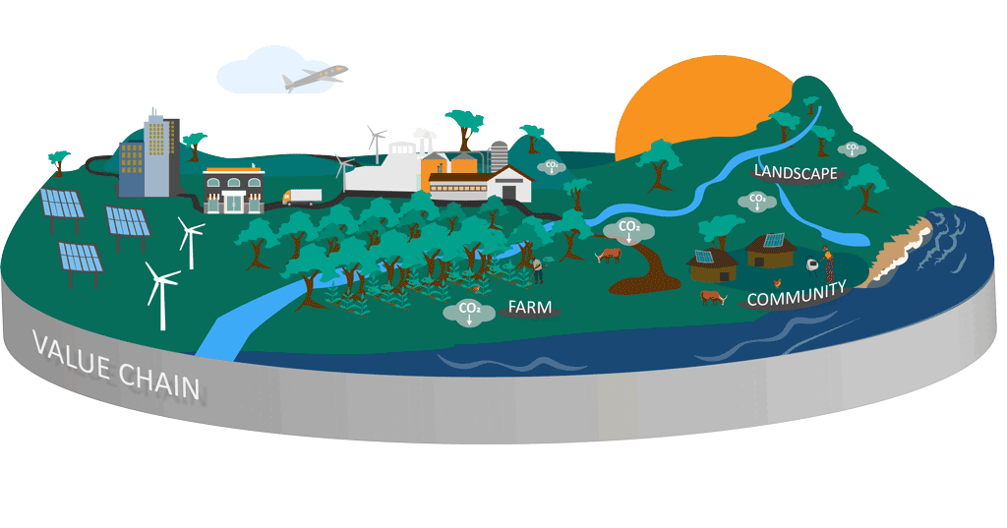
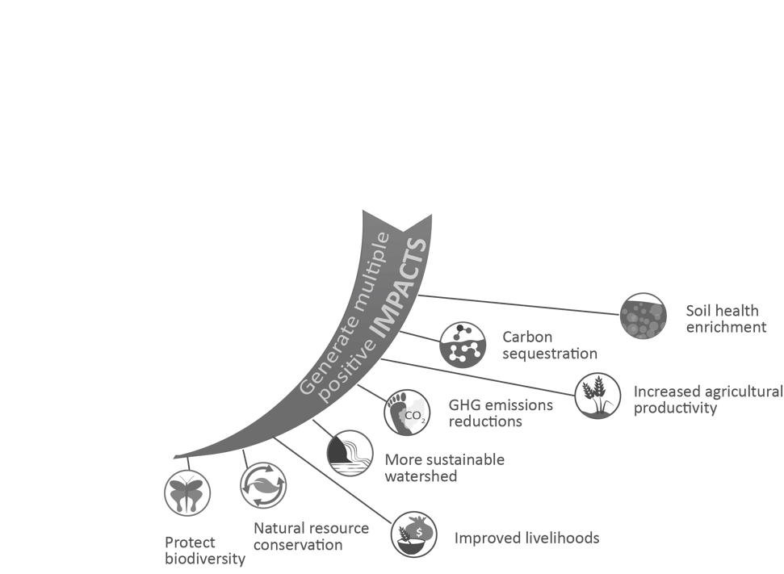
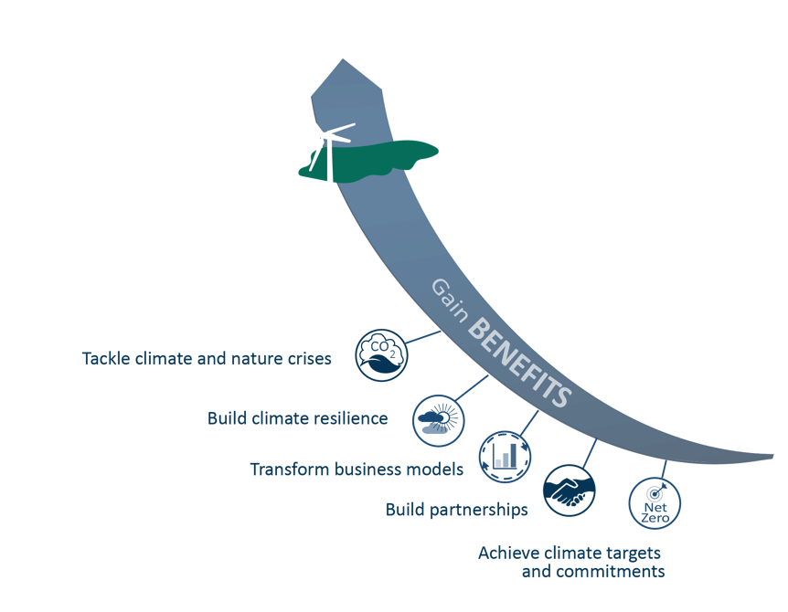
What is Insetting?
Insetting projects are interventions along a company’s value chain that are designed to generate GHG emissions reductions and carbon storage, and at the same time create positive impacts for communities, landscapes and ecosystems.
Notes:
Insetting is a way for companies to harmonise their operations with the ecosystems they depend upon and transition to a more sustainable business model.
Insetting projects are interventions along a company’s value chain that are designed to generate GHG emissions reductions and carbon storage, and at the same time create positive impacts for communities, landscapes and ecosystems. Insetting interventions are typically based on regenerative agriculture practices and agroforestry programs both at farm level and with local communities. They re-establish natural carbon sinks through conservation and restoration of the surrounding landscapes including forests, wetlands, coastal and marine ecosystems. They allow companies to achieve corporate sustainability goals, whilst building climate resilience and supply chain stability at the heart of their operations, future proofing their businesses, and improving the quality of raw materials.

Slide 7
World Resources Institute extracts April 2021
But climate ambition overall, and thus demand for REDD+ credits, has yet to materialize at scale. We now stand on the threshold of ramping up that ambition. Ensuring a positive outcome requires observing two overarching principles concerning the demand and supply of credits.
Demand for Credits: Carbon credits must not provide a corporation with an incentive or excuse to delay emission reductions within its own operations and value chain. Offsets must enhance, not dilute, the pace of emissions reduction.
Supply of Credits: Investments must be ecologically and socially sustainable and must meet a set of standards ensuring integrity — in terms of Paris-aligned levels of ambition, additionality, permanence, and avoidance of leakage and double counting.
Notes:
More than 1,500 companies have committed to net-zero emissions by mid-century, as have 11,000 cities and at least $9 trillion in private assets under management. This raises crucial questions as to how much offsetting of carbon can take place in mid-century and, more importantly, how much can take place on the path to get there. The January 2021 report of the Taskforce on Scaling the Voluntary Carbon Market suggested a market of 1-5 Gigatons of CO2e by 2030, with perhaps two-thirds directed at Nature Based Solutions (NBS), meaning that tens of billions of dollars of investment in NBS are potentially at stake.
REDD+ is a voluntary climate change mitigation approach that has been developed by Parties to the UNFCCC. It aims to incentivize developing countries to reduce emissions from deforestation and forest degradation, conserve forest carbon stocks, sustainably manage forests and enhance forest carbon stocks.

Slide 8
World Resources Institute (cont ..)
In the Paris Agreement era, vocabulary from the Kyoto Protocol needs to be left behind; we need a new vocabulary for a new age of aggressive climate action.
Among other things, this means that corporations should be permitted to purchase carbon credits only as a supplement to aggressive action within their own operations and value chain — and consistent with science-based targets — investing in NBS credits to “counterbalance” their residual emissions as they decarbonize towards zero”.
Notes:
Crucially, we argue that companies’ investments in NBS should only qualify for consideration as carbon credits if the company can demonstrate that it is doing all that it should to eliminate carbon emissions from its operations and value chains, aligned with Science-Based Targets.
In the Paris Agreement era, vocabulary from the Kyoto Protocol needs to be left behind; we need a new vocabulary for a new age of aggressive climate action. Among other things, this means that corporations should be permitted to purchase carbon credits only as a supplement to aggressive action within their own operations and value chain — and consistent with science-based targets — investing in NBS credits to “counterbalance” their residual emissions as they decarbonize towards zero.

Slide 9
Corsia – an Opportunity?
The “jurisdictional approach” is gaining traction. To date, NBS credits in the voluntary market have only been generated at the project scale. But momentum is growing toward the “jurisdictional approach,” which refers to a “government-led, comprehensive approach to forest and land use across one or more legally defined territories” (e.g., state, country)
The International Civil Aviation Organization’s “Carbon Offsetting and Reduction Scheme for International Aviation” (ICAO CORSIA), one of the first sector-wide carbon offsetting programs, has approved only jurisdictional-scale REDD+ crediting programs as meeting its offset eligibility criteria and disallows project-level REDD+ crediting.
Corporate Financing of Nature Based Solutions: What Next? | World Resources Institute (wri.org)
Notes:
Bankers without Borders – Milan project as example
Corporate Financing of Nature Based Solutions: What Next? | World Resources Institute (wri.org)

Slide 10
Carbon Credits and “Patient Capital”
In the early stages of market development for any new infrastructure investment, securing new sources of capital helps accelerate critical mass and scale.
Experts at MITi have pointed out that, compared to the information technology software and medical sectors, “clean-tech clearly does not fit the risk, return or time profiles of traditional venture capital investors. … As a result, the sector requires a more diverse set of actors and innovation models; in other words, more “patient capital”
Notes:
Patient Capital = Specialist Patient Capital funds, Impact investors, Climate Finance funds, Green Municipal bonds, Green performance bonds etc
Bankers without Borders - Milan

Slide 11
USA Project Example
A coalition of electric vehicle (EV) stakeholders use the carbon credit markets to improve EV charging infrastructure revenues and thus help support continued EV sales growth.
The Electric Vehicle Charging Carbon Coalition (EVCCC), provides a blueprint to certify the reduction in greenhouse gas (GHG) emissions that result when EVs are powered by electric vehicle charging stations compared with conventional vehicles and fossil fuels. These reductions translate into carbon credits that can be sold to help improve current EV infrastructure revenues and make future investments more attractive.
Members include the Carbon Neutral Cities Alliance (CNCA), Connecticut Green Bank, Electrify America, EVgo, Exelon, and Siemens. Leading the project is the Climate Neutral Business Network (CNBN) which developed the methodology with the EVCCC and the Verified Carbon Standard (VCS) program, managed by Verra.
EVCCC’s business case .. the carbon credit revenues from EV charging systems could contribute a 5-10 percent return on capital investment (over the ten year project crediting period).
Notes:
A coalition of electric vehicle (EV) stakeholders has developed an innovative pathway to use the carbon credit markets to improve EV charging infrastructure revenues and thus help support continued EV sales growth.
The new method, pioneered by the Electric Vehicle Charging Carbon Coalition (EVCCC), provides a blueprint to certify the reduction in greenhouse gas (GHG) emissions that result when EVs are powered by electric vehicle charging stations compared with conventional vehicles and fossil fuels. These reductions translate into carbon credits that can be sold to help improve current EV infrastructure revenues and make future investments more attractive.
The EVCCC founding members include the Carbon Neutral Cities Alliance (CNCA), Connecticut Green Bank, Electrify America, EVgo, Exelon, and Siemens. Leading the project is the Climate Neutral Business Network (CNBN) which developed the methodology with the EVCCC and the voluntary carbon market’s leading third-party certifier, the Verified Carbon Standard (VCS) program, managed by Verra.
Based on range of carbon market boutique pricing and prevailing utilization rates for EV charging systems, EVCCC’s original business case indicated that the carbon credit revenues from EV charging systems could contribute a 5-10 percent return on capital investment (over the ten year project crediting period).

Slide 12
Emtec UK Project
EMTEC is using the VCS/Verra methodology VM0038 “Methodology for Electric Vehicle Charging Systems” and is collaborating with the methodology’s Originators [EVCCC and CNBN].
A UK-based technology initiative to connect carbon reduction projects of UK Local Authorities with carbon credit buyers from all Carbon Markets/OTC sources and provide transparent governance for all parties, real-time assessment of fund deployment and verification of its environmental impact.
Innovation comes from use of carbon insetting protocols into the local community and supply-chain, delivering environmental benefits at scale across the UK, and includes a digital measurement, reporting and verification (MRV) process.
Our US collaborating partners describe our process as highly innovative and exciting.
Notes:
EMTEC is using the VCS/Verra methodology VM0038 “Methodology for Electric Vehicle Charging Systems” and is collaborating with the methodology’s Originators [EVCCC and CNBN].
EMTEC is developing its transport emissions and vehicle tracking platform towards a peer-to-peer carbon trading platform, initially using EV chargers as the underlying methodology. Our project is a UK-based initiative to connect carbon reduction projects of UK Local Authorities with carbon credit buyers through all Carbon Markets/OTC sources and provides transparent governance for all parties, real-time assessment of fund deployment and verification of its environmental impact.
Innovation comes via a) carbon insetting protocols into the local community and supply-chain, delivering environmental benefits at scale across the UK, and b) a DLT blockchain development that includes a digital measurement, reporting and verification (MRV) process that in addition to the trusted transparency delivered also ensures GDPR approved, open data sharing is available for climate science-based analysis.

Slide 13
Questions?

Slide 14
‘Additionality’ – Evolving?
‘Additionality’: GHG reductions are additional if they would not have occurred in the absence of a market for offset credits. If the reductions would have happened anyway – i.e., without any prospect for project owners to sell carbon offset credits – then they are not additional. Additionality is essential for the quality of carbon offset credits – if their associated GHG reductions are not additional, then purchasing offset credits in lieu of reducing [a Corporate’s] own emissions will make climate change worse.
“Climate discussions have not yet caught up with incentivising good behaviour. It’s not fair, but that’s how it is” Prof Mark Maslin, (Earth Systems Science, UCL)
“Carbon finance should aim beyond climate impact only and be a transformational engine to sustainable development. The new principles will drive more much needed funding into impactful climate projects across the world, particularly important for emerging economies where it must deliver a plethora of social benefits combined with the environmental impacts” Ecosecurities/TSVCM commentary
Strong plea to TSVCM for ‘Permitted Use’ categories – South Pole
Clear examples of ‘Additionality’ being ignored/interpreted – OTC Global corporates making their own judgements e.g., LEAF, Project Vista,

Slide 15
Emtec Background
UK Technology SME, Based at Exeter Science Park, founded 2017
Developed unique telematics-based methodology that measures vehicle carbon emissions in real time. Measurement solution is featured as a case study on National Physical Laboratory website
Winner of two Innovate UK Grants
Consultancy Group member of Mark Carney’s Taskforce for Scaling Voluntary Carbon Markets (TSVCM)
Emtec is not a Financial Adviser or source of Financial Capital

