Slide 1
COLLABORATING ON A SUB-REGIONAL APPROACH TO LOCAL AREA ENERGY PLANNING
HSPG Mini Summit
Thursday 27th January 2022, 1pm-3pm, Microsoft Teams

Slide 2
DECARBONISING THE SUB REGIONAL AREA
How do we start the process of transitioning an entire region to a net zero carbon energy system? Most boroughs have declared a climate emergency and set ambitious targets.
Where should low carbon interventions be prioritised? And balanced with emerging development.
Which technologies should we be focusing on and be deployed to decarbonise heat?
How much capacity does the network have across the region? If the network is constraint, what is the alternative solutions?
What houses are on or off the gas network and how much of the gas network is hydrogen ready? Fabric first approach?
How much will it cost your borough/region to reach net zero and how can boroughs simulate different scenarios? And generate the investment to fund the schemes.
What are the impacts of the energy transition to local citizens? Rising costs and security of energy supply will result in an unequal impact.

Slide 3
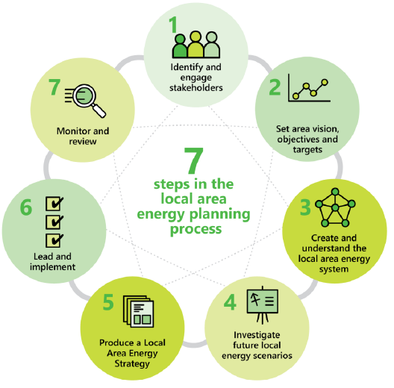
LOCAL AREA ENERGY PLAN
A LAEP is a concept developed by the Energy Systems Catapult to enable data driven, spatial and collaborative planning to help unlock investment and delivery of smart local energy systems – summarised in seven steps in the diagram.
There are 4 key elements that constitute LAEP:
robust technical evidence
wider non-technical factors which need to be understood and addressed to secure change
well designed and involving social process which engages appropriate stakeholders
credible and sustained approach to governance and delivery
Notes:
LAEP will cost a borough approximately £150,000 (depending on population size). Currently exploring opportunities for sub regional collaboration to reduce cost, improve efficiency and delivery.

Slide 4
A WEST LONDON LAEP
Identification of the key stakeholders responsible for and impacted by the net zero transition across the WL region
The setup of a regional consortium group responsible for shaping and leading a plan for across West London.
A review of stakeholder plans and objectives to shape a regional net zero vision for WL
The collation, review and analysis of all energy and emissions data across each LA
GIS spatial mapping of the existing energy system and socio-economic factors for each local authority within WLCEG

Slide 5
A WEST LONDON LAEP
High level assessment of residential homes suitable for Solar PV and EV charging
Review of GLA ‘Accelerated Pathway’ Scenario and scenario recommendations for West London - Commitment from the GLA to support and potentially fund this work.
Output report capturing Stakeholder needs and targets, surmising insights from energy mapping and recommendations/next steps
Training and support materials for implementing LAEP methodology
Rising costs and security of energy supply, resulting in an unequal impact – working collaboratively will enable us to plan better and ultimately reduce end costs and improve resilience when compared to the Do Nothing or BAU scenario.

Slide 6
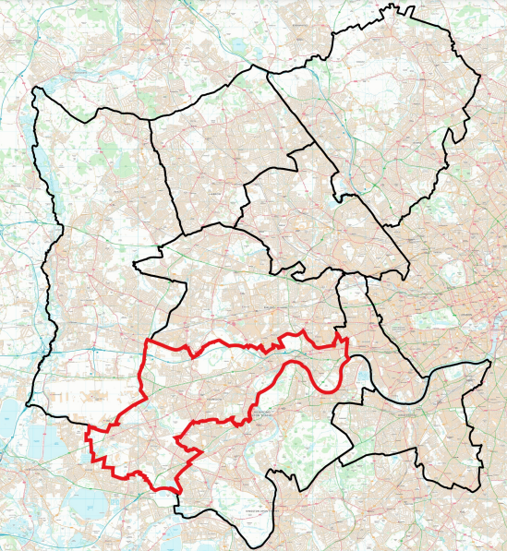
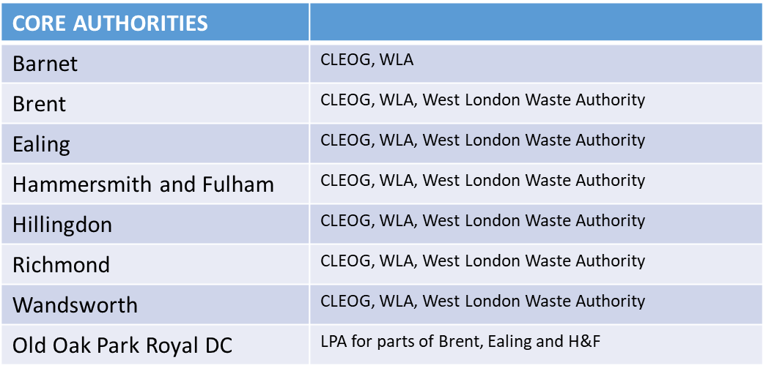
GEOGRAPHICAL AREA

Slide 7
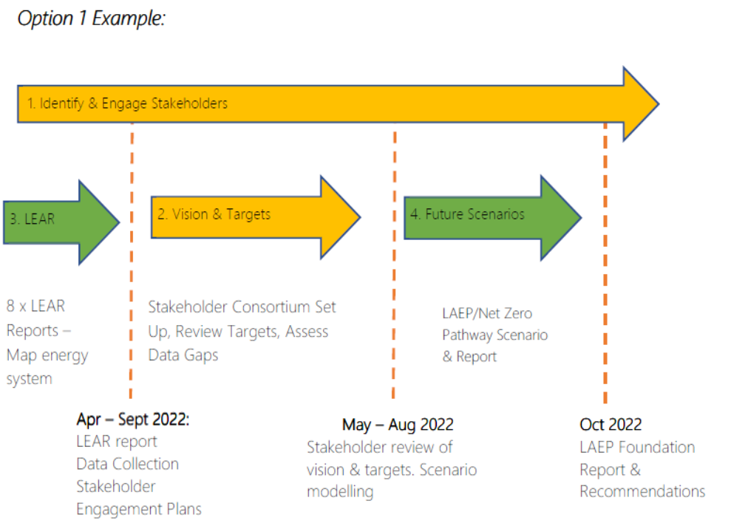
TIMESCALES
A LAEP can take between 7-12months to complete.
It is estimated that the sub regional WL LAEP (stages 1- 4) can begin in April 22 with final reports and recommendations being made available by October 2022.
Note – Purdah starts 28th March 2022. May limit any community and Member engagement.

Slide 8
ENGAGING WITH THE HSPG AND HEATHROW
HSPG recognised that there is no hard boundary on the edge of London.
Heathrow and the functional economic area covers a region which will benefit for collaborating on a sub regional approach to LAEP
Scope for the WL LAEP is being finalised – there are opportunities to partake in the process and develop the evidence base for energy infrastructure planning across the sub region, meet the LPAs duty to cooperate requirements, strengthen stakeholder engagement with utility companies and businesses i.e. Heathrow and enable us to achieve our ambitious net zero targets can be delivered.
Resource and capacity maybe an issue but we are keen to ensure HSPG and Heathrow are part of the stakeholder coalition collaborating with us the WL region to take this work forward.
Notes:
Aware that many boroughs are interested and keen to learn more but
Elmbridge, Slough and Spelthorne

