Slide 1
HSPG Reflections on 21-22 & Priorities for 22-23
HSPG Mini-Summit
27 January 2022

Slide 2
HSPG - Current structure
Representation at Heathrow’s new Council for Independent Scrutiny of Heathrow
HSPG Mini Summit 2-3 x year
- Chaired by leaders from funding bodies in rotation
- All officers invited, sub-group feedback encouraged
- Opportunity to share the ‘big picture’, spotlight ‘themes’ of interest, promote partnership, increase profile and invite guests
HSPG/HAL Executive Partnership Board
Leaders/LEP CEXs and portfolio holders
HAL Chief of Staff
3 x year
HSPG Secretariat
Support and coordinate HSPG activity across partnership
Chief Officer Steering Panel
Input / soundings from CEX/Exec Directors from contributing HSPG members on key strategic matters
Bi-monthly working groups
Surface Access Group
Economic Development & Renewal Group
Spatial Planning Group
Environment and Airspace Group

Slide 3
HSPG 21-22 Strategic Objectives
Maintain functional partnership ahead of any further decisions on expansion
Develop officer and political relationships across the functional economic market area and GLA boundary and explore opportunities to better exploit unique geography of partnership
Maximise collaboration between members, HAL, HMG and other parties on longer-term economic recovery and renewal of the sub-region.
Maximise opportunities to engage HAL in meaningful and sustained partnership working, given their strategic challenges / shared interests
Explore opportunities for more proactive member collaboration and on specific projects given HAL’s reduced role in agenda setting

Slide 4
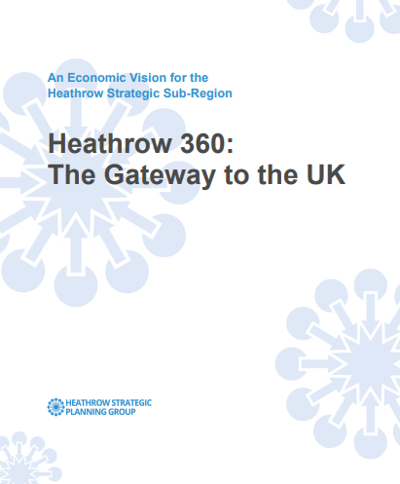
HSPG 21 -22 – Highlights
Completed a refresh of the Economic Development Vision & Action Plan: Heathrow 360
Began the development of a roadmap for applying the carbon ‘insetting’ concept in the HSPG area
Developed sub-regional understanding around the ‘local area energy planning’ (LAEP) process, contributed to workshops and specifications to develop
Scoped further work on the Joint Strategic Planning Framework and associated evidence bases

Slide 5
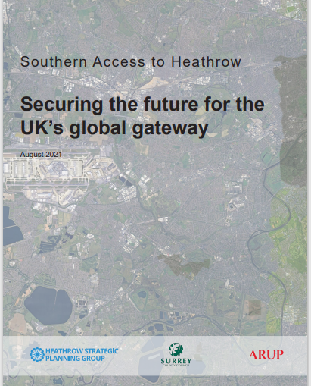
HSPG 21 -22 – Highlights
Submitted consultation responses to Heathrow, DfT, CAA on a wide range of subjects important to future of aviation / airport / climate emergency
Developed a position statement on Southern Rail Access; a funding bid to National Highways to support active travel improvements; and responded to Heathrow’s new Surface Access Strategy and Sustainable Travel Zone
3 mini summits, covering a range of topics from decarbonisation to southern rail access, 24 meetings of our thematic working groups, 2 Chief Officer meetings and 3 executive partnership boards.

Slide 6
December Strategy Planning Day: Reflections
Recovery to renewal reflecting the need for change and development in Heathrow’s role, but maintaining the focus around ‘Heathrow 360’ and the airport multiple hub functions:
Integrated surface transport hub
Energy hub
Business hub
Sustainability hub
Clear need for HSPG to act as a unified voice for stakeholders to amplify their voice to Heathrow and Government
Complement HAL Heathrow 2.0 Refresh with a Statement of Common Ground on Sustainable Growth for HSPG area.
A need to respond effectively to the moving parts at a national level – particularly in relation to funding for London and county deals etc

Slide 7
HSPG 22-23 Strategic Objectives
Continue to develop officer and political relationships across GLA boundary and explore opportunities to better exploit unique geography of partnership
Maximise support for collaboration between members, HAL, HMG and other parties around longer-term economic recovery and renewal of the sub-region: specifically building on EDVAP refresh to develop a wider HSPG statement on Sustainable Growth
Further develop proactive collaboration by members on specific projects particularly to contribute to achieving Net Zero and adaptation to climate change
Enhance the evidence base about economic and other changes in the HSPG area and the implications for spatial planning
Diversify funding sources and secure external funding

Slide 8
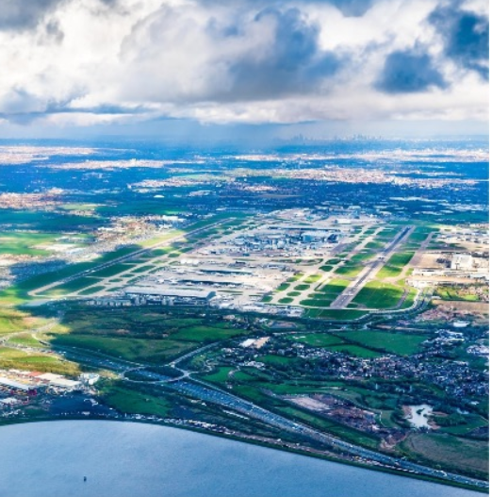
HSPG Emerging Workplan for 2022-23
‘Rowing’
Developing an ambitious sub-regional response to Heathrow 2.0 refresh, including identifying the infrastructure required to deliver decarbonisation aspirations, building on the idea of the airport as an ‘energy hub’ and through the Local Area Energy Plan process.
Developing the ‘Insetting’ and ‘Local Offsets Market’ concepts to secure funding into projects that deliver decarbonisation outcomes
Refresh of the Joint Strategic Planning Framework, inform any work on new airport masterplanning. Undertake airport and logistics and employment land demand studies, and collaborate on other joint evidence studies and investigations to help inform the revised framework .
Explore opportunities for optimisation/ decarbonisation of freight and logistics activity in the area – analysis and options study
Submit bid to National Highways Designated Fund for active travel improvements across sub-region

Slide 9
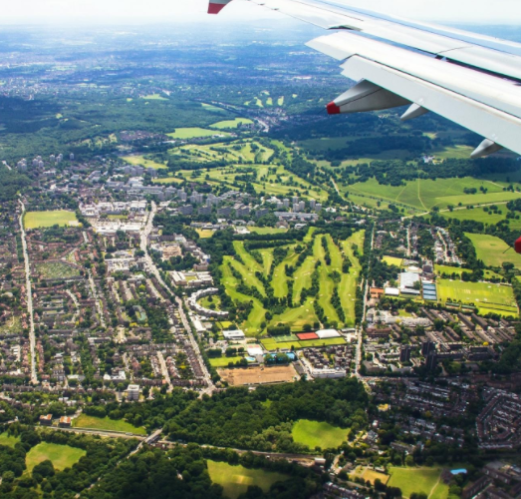
HSPG Emerging Workplan for 2022-23
‘Steering’
Continue to lobby for further funding for improved sustainable transport infrastructure to the airport, notably western and southern rail access enhancements. Launching new position statement on Southern Access in partnership with HAL and DfT
Developing a sub-regional statement on employment & skills; continue to explore collaboration opportunities around ‘green skills’.
Representations to CAA as economic regulator of the airport in order to secure further attention is paid, and funding released for, partnership priorities – particularly around decarbonisation and mitigating negative impacts of the airport on communities.
Making representations to Heathrow Airspace Change Process, night flying and noise policies (support collaboration by members – conduit to HAL, CAA/DfT and wider world for best practice)

Slide 10
HSPG Emerging Workplan for 2022-23
‘Cheering’
Keep under review relevant developments in the UK and international aviation policy framework, inc. Airport National Policy Statement refresh and UK Airspace Modernisation Strategy
Continue collaboration across partnership on the London West Innovation District concept
Continue collaboration on spatial planning and economic renewal across the GLA boundary, including through the Wider South East Strategic Planning Network
Make representations as appropriate to relevant consultations on strategic transport infrastructure requirements for the sub-region, including those undertaken by Great British Railways, National Highways (new Road Investment Strategy) and National Infrastructure Commission (National Infrastructure Assessment).

Slide 11
HSPG 22-23 Priorities - Reflections
Secretariat are keen to get participant feedback on our plans for 22/23
Please visit Slido.com #HSPG for three quick questions.

