Slide 1
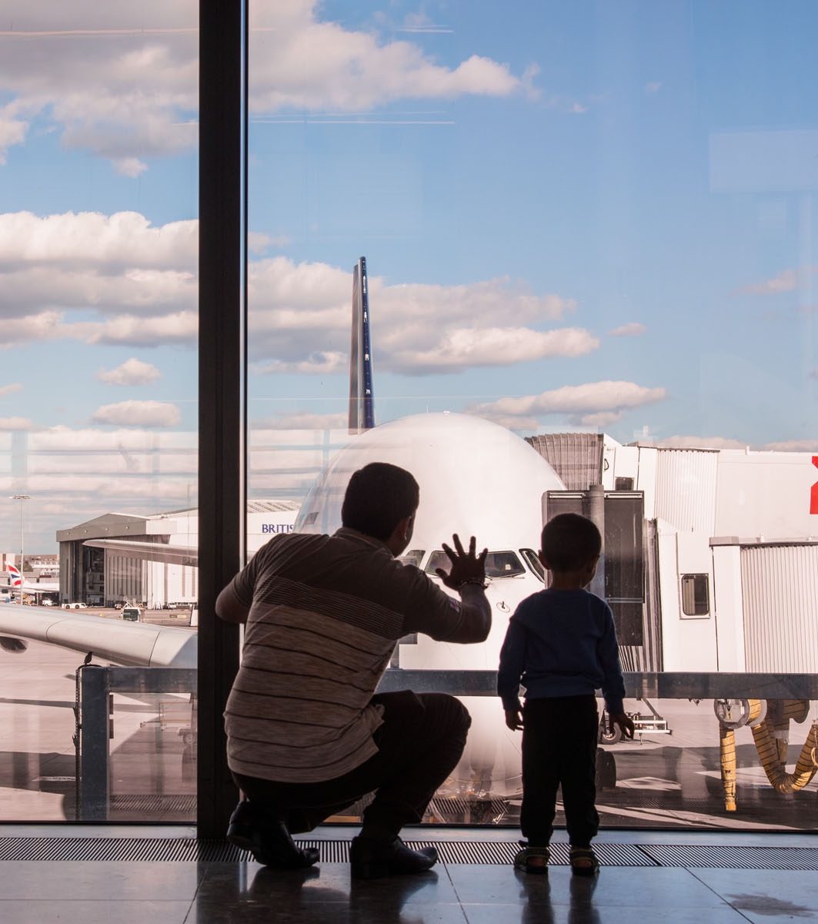
Aviation’s path to net zero

Slide 2
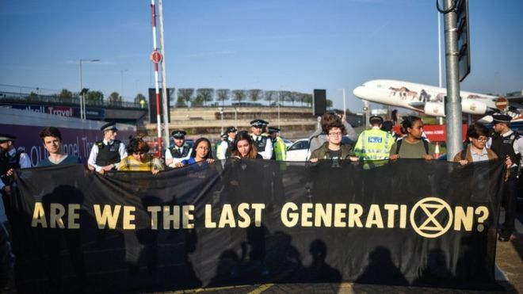
Aviation is a force for good – to protect its benefits we must decarbonise
Extinction Rebellion Protest, Heathrow, 2019
2

Slide 3
Heathrow cannot solve carbon alone
Heathrow’s carbon footprint
Surface access, procurement & airport vehicle fleet
0.99Mt
4.7%
Eliminating emissions on the ground
HAL buildings & infrastructure
0.03Mt
0.1%
Planes
20Mt
95.1%
Getting our own house in order
“Scope 3”
Emissions in our value chain
“Scope 1 and 2”
Emissions from fuel we burn
as HAL and electricity we buy
3

Slide 4
We can take the carbon out of flying even as we grow
Today
By 2050
“Change the
plane”
“Change the
fuel”
“Remove
the rest”
Use less fuel
Base case: traffic growth using current tech
c.70Mt
6%
70% growth, includes
Heathrow R3
Reduced demand from
carbon pricing
4%
Ops
efficiency
33%
Sustainable
Aviation Fuel
c.40Mt
Improved
conventional
aircraft
<57%
Paying for
natural &
engineered
removals
tbc
Electric /hydrogen for short-haul
To close any gap to zero
0Mt
Emissions from UK aviation – million tonnes (Mt) of CO₂ per year
Adapted from Sustainable Aviation Pathway to Net Zero
4

Slide 5
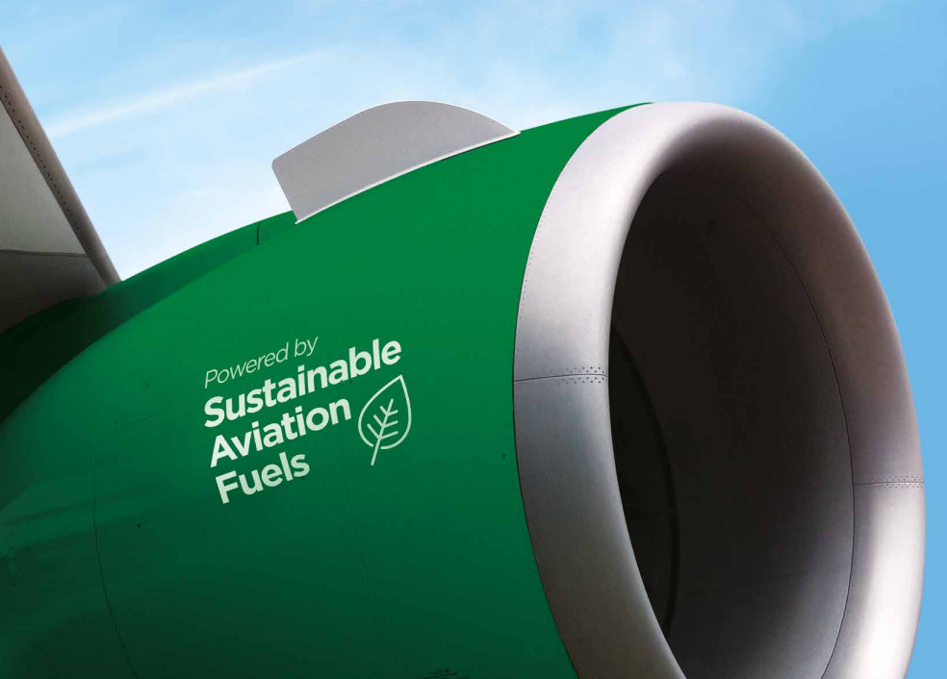
Airlines need help to make SAF commercially viable – costs <5x times more
Decisive Government action is needed:
Stimulate supply with an escalating fuel mandate
Stimulate demand with the right price support mechanism
Action needed from Government
5

Slide 6
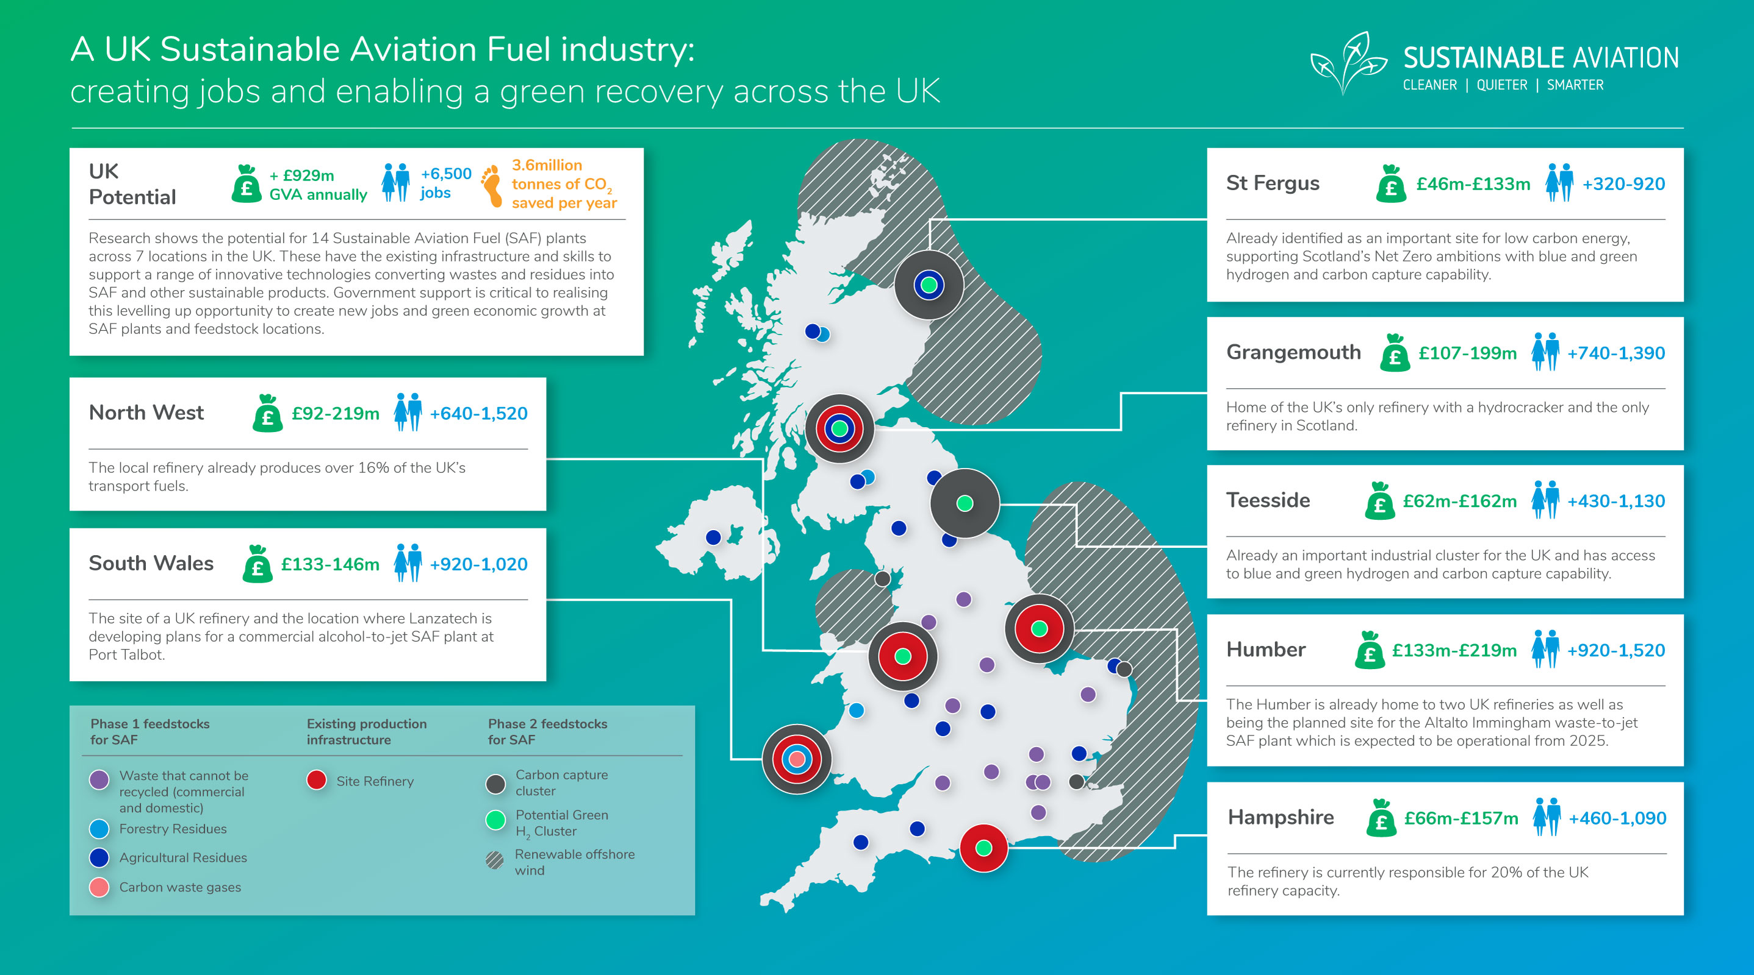
The case for SAF is economic as well as environmental
6

Slide 7


The solutions to net zero flying exist – we need urgent Government action to scale them
All BA flights between London, Edinburgh and Glasgow during COP26 will use SAF

Slide 8
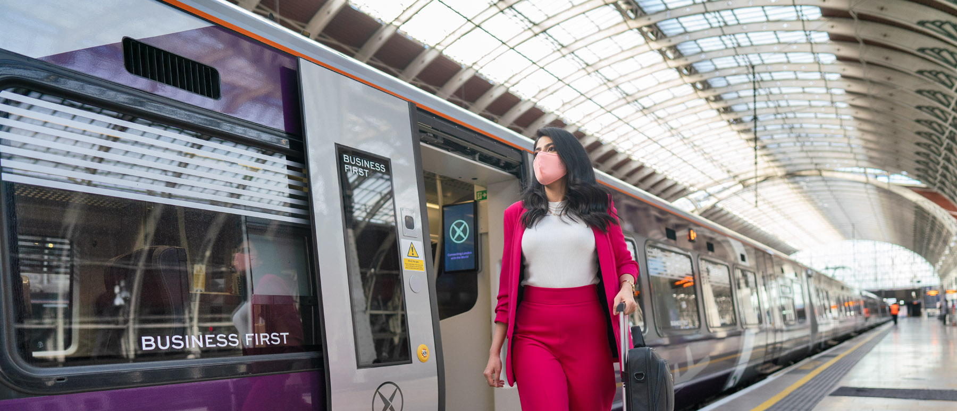
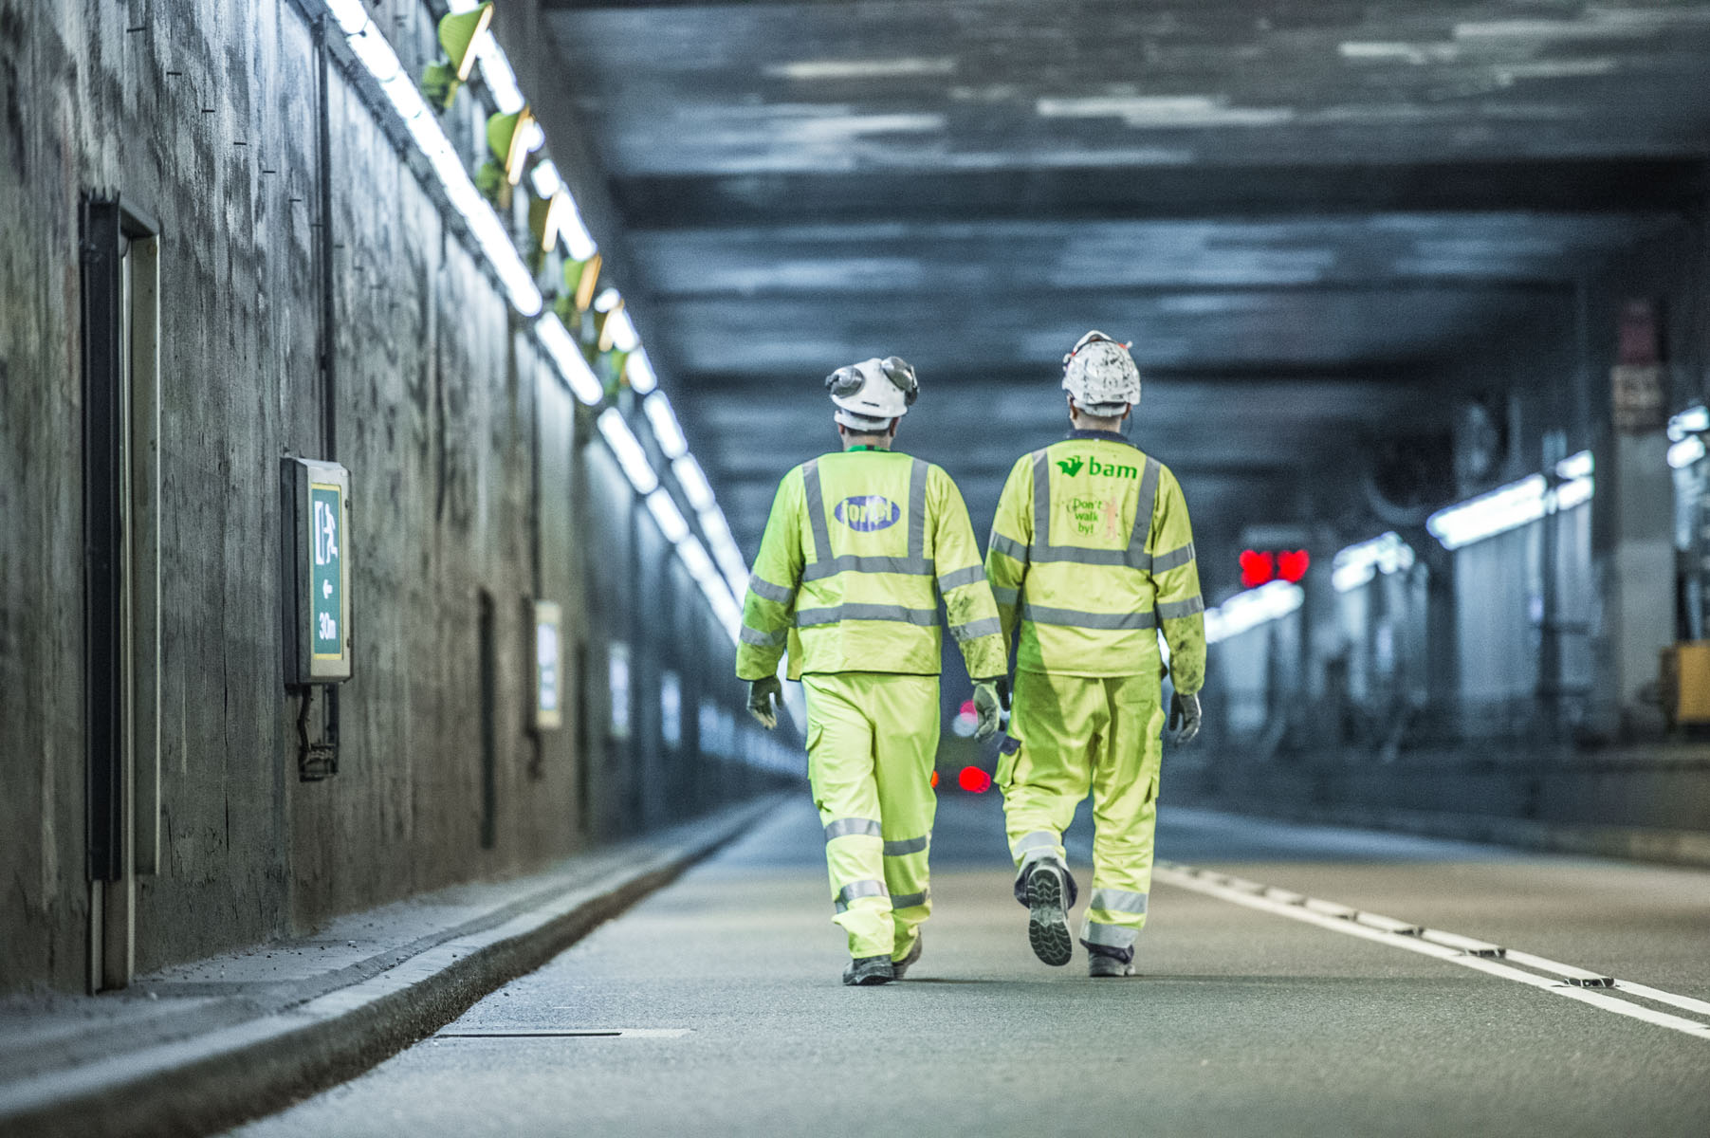
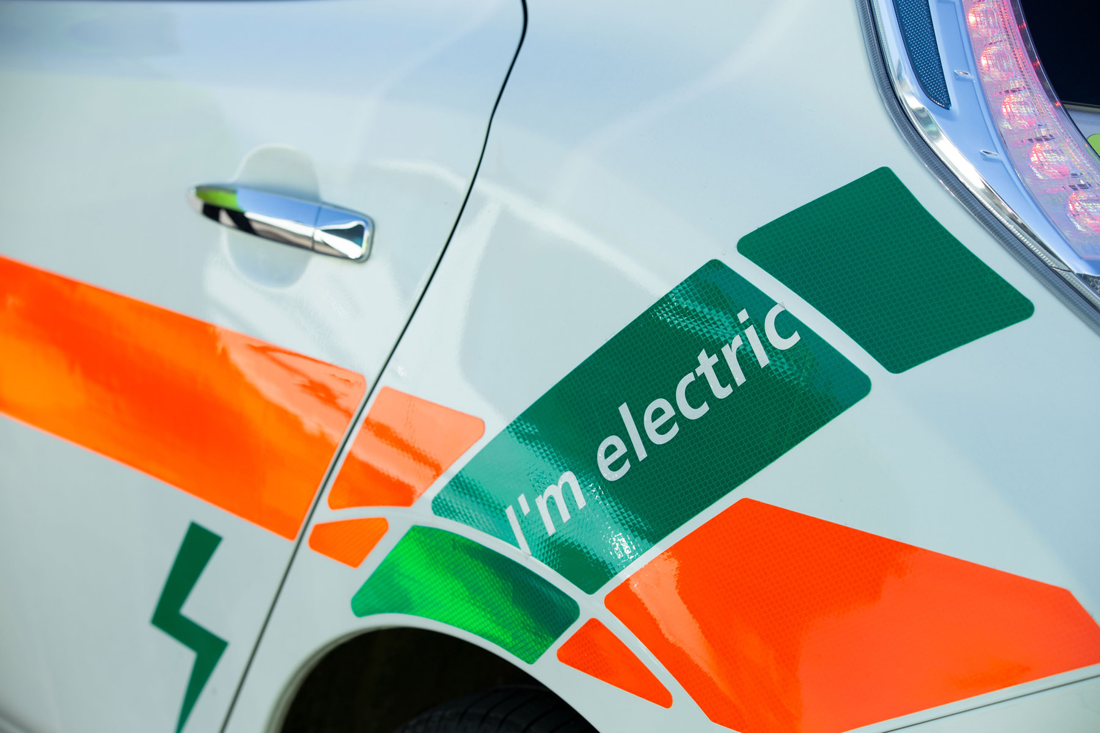
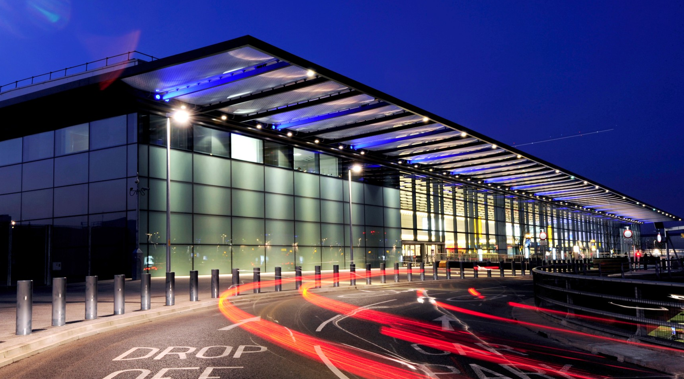
We can take the carbon out on the ground too
Enable net zero for passenger and colleague surface access
Leverage our procurement role to deliver a net zero supply chain
Shift airport vehicles to zero carbon
Get our buildings and infrastructure to zero carbon
Classification: Confidential

Slide 9
Delivering a net zero airport and sub-region - areas for discussion & collaboration
Electricity provision: we need enough electricity to scale up electrical solutions (heating, EVs etc).
        Demand side measures – efficiency
        Supply side measures – local renewable generation?
        Collective discussion with National Grid
  Electric (and hydrogen) vehicles: Heathrow is developing a strategy for EV charging – how much, where, who provides it. How can we work together to ensure the right assets in the right locations to help enable the shift to EVs?
Notes:
add another slide after this that takes CCC / Govt inclusion of aviation in UK budget and shows LHR share of that to show how our emissions would have to fall by 2030, 2040 and 2050?
We are showing CCC balanced scenario – should we show the aviation emissions as a range across their scenarios from optimistic to pessimistic?
P12 – after this can we show a Heathrow carbon footprint (scope 1,2,3) over time – to show change since 1990 or 2010, show 2019 as peak year and likely glide path at Heathrow (likely ranged) to 2030 etc. This will allow us to (i) land point we have peaked in emissions already (ii) show how far / tough it will be to meet CCC budgets with efficiency/aircraft + airspace change + on ground change + currently committed SAF

Slide 10
“The journey to zero carbon is a permanent one.
Let’s celebrate being the generation that will get the job done.”
Chris Stark, CEO, Climate Change Committee

